Slide 1
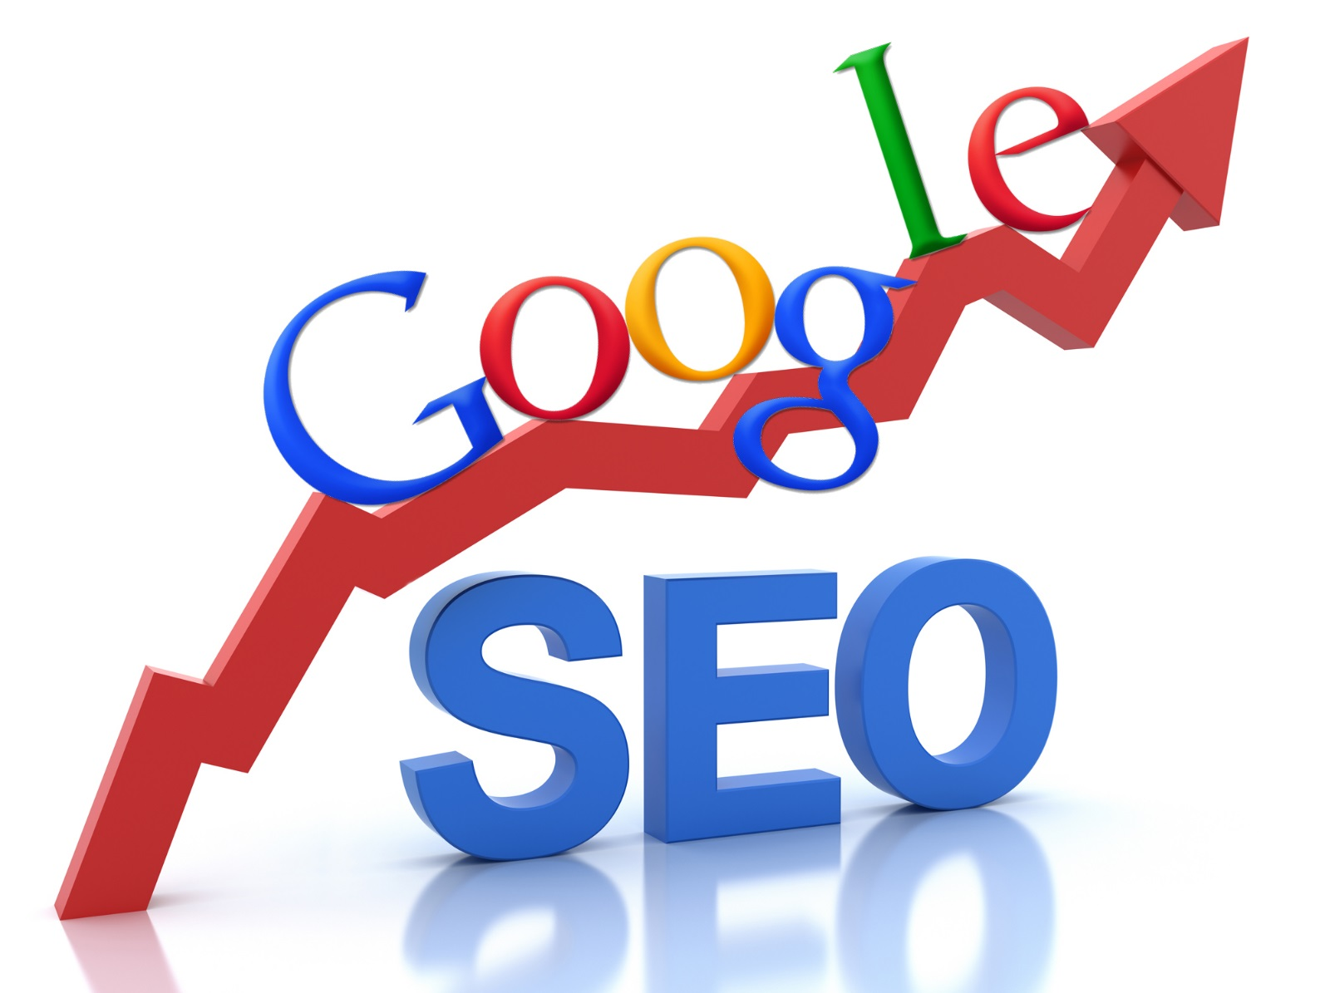
SEO

Slide 2
What to cover this class?
How does search engine work?
What is SEO?
SEO guidelines

Slide 3
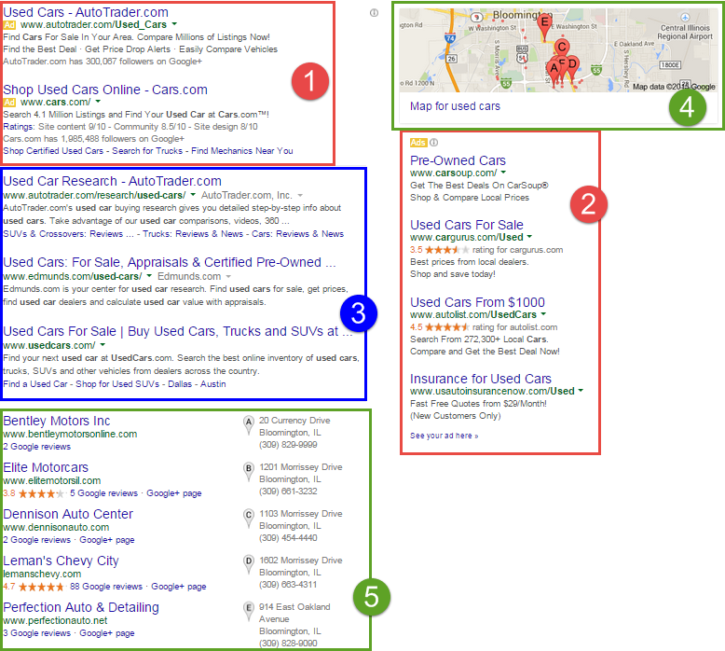
Search Results
Made up of organic and paid sections
AdWords from Google
https://www.youtube.com/watch?v=CY1wYKq5sLU
Notes:
1 & 2 are paid,
3 is organic
4 & 5 are local packs
Others: News, Video, General information, “Also searched for”

Slide 4
How much a click cost?
The average cost per click in Google AdWords is between $1 and $2 on the search network.
The most expensive keywords in AdWords and Bing Ads cost $50 or more per click. These are generally highly competitive keywords in industries that have high customer lifetime values, like law and insurance.
Giant retailers can spend up to $50 million per year on paid search in AdWords.
The average small business using AdWords spends between $9,000 and $10,000 per month on their Google paid search campaigns. That's $100,000 to $120,000 per year.
https://www.wordstream.com/blog/ws/2015/05/21/how-much-does-adwords-cost
https://www.hochmanconsultants.com/cost-of-ppc-advertising/

Slide 5
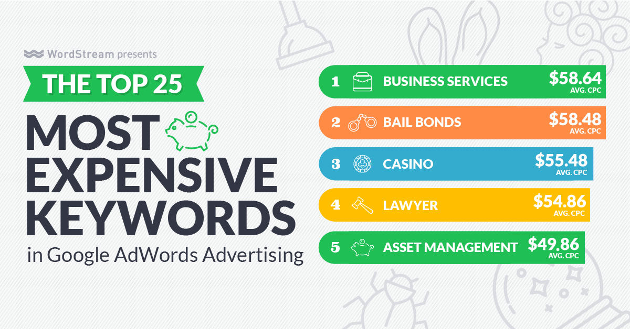
https://www.wordstream.com/blog/ws/2017/06/27/most-expensive-keywords

Slide 6
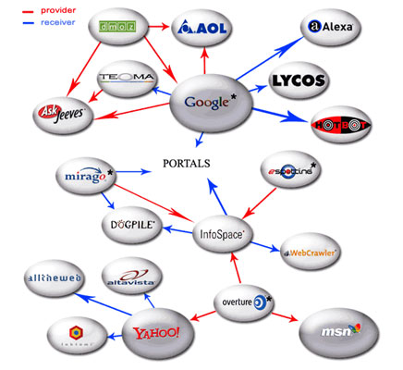
How does search engine work?
Search engines have two major functions:
crawling and building an index, and
providing users with a ranked list of the websites they've determined are the most relevant.

Slide 7
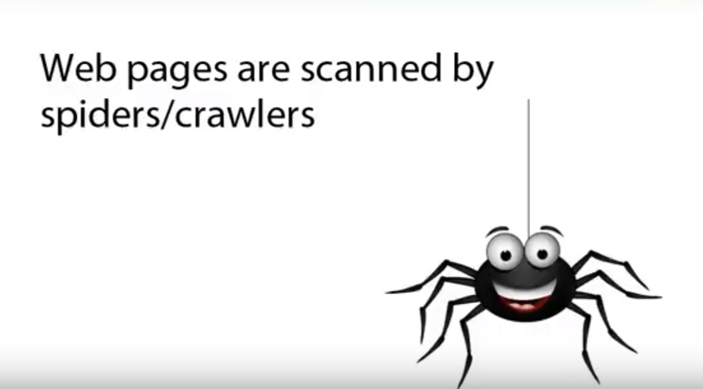
Yahoo: Slurp
Google: Googlebot
Bing: BingBot
https://www.keycdn.com/blog/web-crawlers/
https://www.youtube.com/watch?v=BNHR6IQJGZs

Slide 8
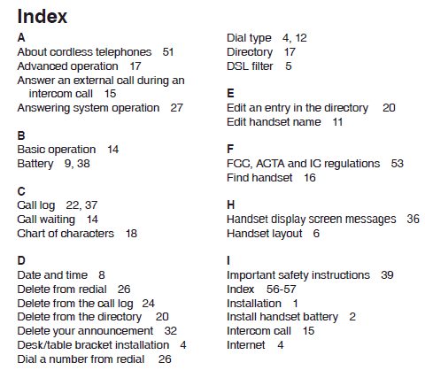
Index: a list of information, with instructions on how to find that information
Search engines gather the pages during crawl process and then create an index.
Include information about words and their locations.

Slide 9
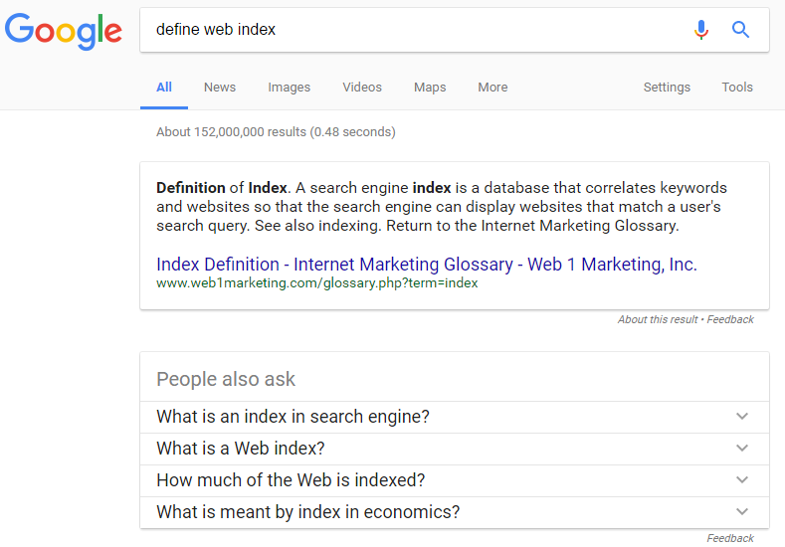

Slide 10
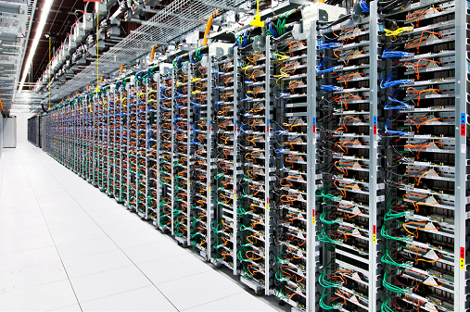
The websites that Google ranks on the 1st page of its search results for any given search term are the ones that they consider to be the most relevant and useful.
They determine which websites are the most useful and relevant by using a complex algorithm (mathematical process) which takes into account 200 + different factors.
Source: http://www.seomark.co.uk/how-does-google-rank-websites/#ixzz4a8gbL7TE

Slide 11
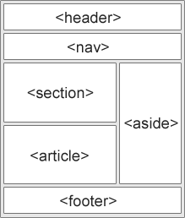
Page ranking
Google doesn’t let people know what those factors are.
The following are all important ranking factors…
Keyword usage
Site structure
Site speed
Time spent on site
Number of inbound links
Quality of inbound links Source: http://www.seomark.co.uk/how-does-google-rank-websites/#ixzz4a8iLvheF
https://www.w3schools.com/html/html5_semantic_elements.asp

Slide 12
What is SEO?
Search engine optimization (SEO), is a set of rules that can be followed by website (or blog) owners to optimize their websites for search engines and thus improve their search engine rankings.
If you have a web site, blog or online store, SEO can help your business grow and meet the business objectives.
https://www.reliablesoft.net/what-is-search-engine-optimization-and-why-is-it-important/
Tutorial https://www.youtube.com/watch?v=F2jfZ9AwwAQ&list=PL6gx4Cwl9DGBqMdJssJaiG3c9RooWQiU3

Slide 13
Benefits of SEO
The majority of search engines users are more likely to click on one of the top 5 suggestions in the results pages.
Good SEO practices improve the user experience and usability of a web site.
Users trust search engines and having a presence in the top positions increases the web site’s trust.
SEO can put you ahead of the competition. If two web sites are selling the same thing, the search engine optimized web site is more likely to have more customers and make more sales.
https://www.reliablesoft.net/what-is-search-engine-optimization-and-why-is-it-important/

Slide 14
How much traffic goes to the first search result?

Slide 15
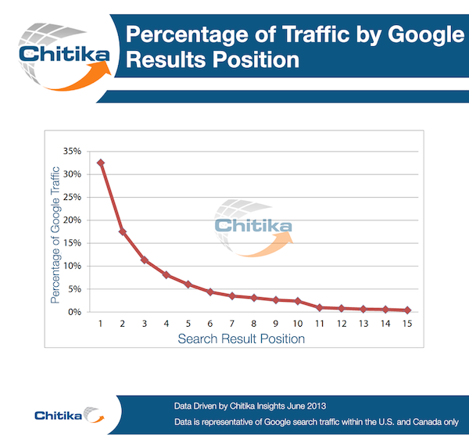
The top listing in Google’s organic search results receives 33 percent of the traffic, compared to 18 percent for the second position
https://searchenginewatch.com/sew/study/2276184/no-1-position-in-google-gets-33-of-search-traffic-study

Slide 16
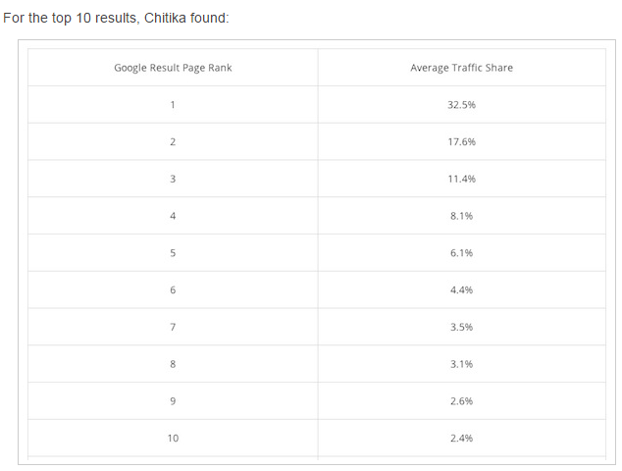

Slide 17
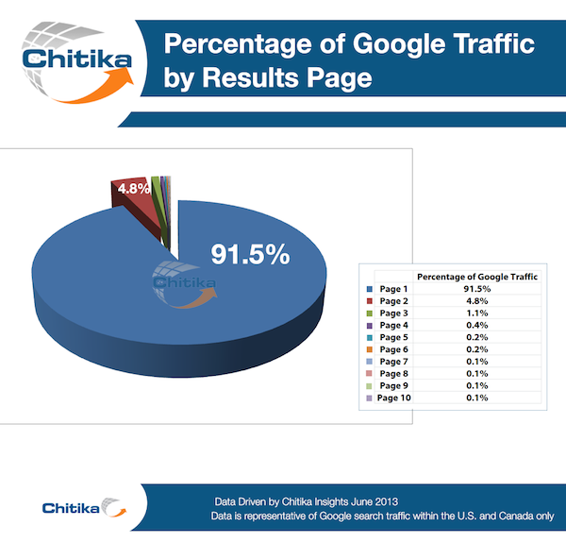

Slide 18
Page titles
The most important characteristics of an optimized page title are:
Each page needs to have a unique page title that accurately describes the page’s content
Be brief and descriptive
Help the user understand what the page is about

Slide 19
Description
The page description meta tag is also very important. It gives users, Google and other search engines a summary of what the page is about.
<head> <title>HTML meta tag</title>
<meta charset="UTF-8"> <meta name="description" content="Free Web tutorials"> <meta name="keywords" content="HTML,CSS,XML,JavaScript"> <meta name="author" content="John Doe"> <meta name="viewport" content="width=device-width, initial-scale=1.0"> </head>
https://www.w3schools.com/tags/tag_meta.asp
Notes:
Metadata is data (information) about data.
The <meta> tag provides metadata about the HTML document. Metadata will not be displayed on the page, but will be machine parsable.
Meta elements are typically used to specify page description, keywords, author of the document, last modified, and other metadata.
The metadata can be used by browsers (how to display content or reload page), search engines (keywords), or other web services.

Slide 20
Description
Always provide a unique description for all pages, post, products of your website.
Keep the size between 155 characters or less.
Avoid repeating the title in the description
Don’t add too many keywords
Try to use the description as a way to ‘advertise’ your page to the reader so that they click on your title and visit the page.
https://www.weidert.com/whole_brain_marketing_blog/seo-6-ways-to-craft-better-meta-descriptions-that-rock-the-serps

Slide 21
SEO guidelines for URLS
Make Urls simple and easy to understand for search engines and users
Use hyphens ‘ – ‘ to separate the words that make up a url
Avoid lengthy URLs with unnecessary information
Use words that describe what the page is about but avoid keyword stuffing
https://www.normalil.gov/CivicAlerts.aspx?AID=2509

Slide 22
Examples of BAD url structures
http://www.example.com/UK/123213/5005.html
http://www.example.com/id=7&sort=A&action=70
Examples of GOOD url structures
http://www.example.com/social-media-news
http://www.example.com/2002/12/social-media-news
A friendly URL is a Web address that is easy to read and includes words that describe the content of the webpage. This type of URL can be "friendly" in two ways.
1) It can help visitors remember the Web address, and
2) it can help describe the page to search engines.

Slide 23
Get links from other websites
Websites that have incoming links from other websites, are probably more important and popular than others, so they deserved a better ranking.
In other words, incoming links counted as ‘votes of trust’ and this had a positive effect on a website’s ranking position.
At the beginning, this was something that could easily be manipulated.
Google started adding more strict rules to their ranking algorithm and they were able to differentiate between natural and artificially created links.

Slide 24
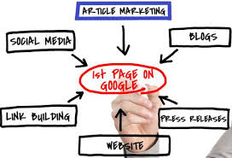
Things about links
Links are still a very important aspect of SEO.
Quality of links
Natural links are good for your rankings, artificially generated links can get you into trouble.
Article marketing- you could write an article, “spin” multiple versions of it, making small adjustments to the wording, and then submit those versions to different websites that collect free articles in exchange for a link back to your site.
https://www.link-assistant.com/news/paid-links.html

Slide 25
Link building mistakes to avoid:
Don’t buy links (avoid any sort of link building packages)
Don’t add your link in low quality websites
Links from comments or forums can sometimes do more harm than good (unless they are genuine and from well trusted sources)
Too many outgoing links is a strong spam signal to Google
Unnatural Anchor Text
“anchor text” refers to the text inside of a link. So, the anchor text in this sentence is “anchor text.”
joke, funny joke, hilarious joke, this makes me laugh
By using the same anchor text in all your links, you’re basically telling Google that you’re trying to game the system.
“Great blog. I also wrote a blog about this hot topic, please check www.were.........”
Notes:
https://smartblogger.com/seo-mistakes/
https://www.link-assistant.com/news/paid-links.html

Slide 26
Your External Links
You are not linking to spam web sites or web sites with inappropriate content
You have no broken links i.e. links to web sites or pages that no longer exist
You are not in any way selling or exchanging links
Any links in your comments section carry the nofollow directive
The nofollow directive is an often used value in a meta tag that can be added to the HTML source code of a webpage to suggest to search engines (most notably Google) not to pass link equity through any links on a given webpage.
<a href="http://www.example.com/" rel="nofollow">Anchor Text</a>
More information can be found https://searchengineland.com/infographic-nofollow-tag-172157
Notes:
Links in blog comments – If you took the time writing a valuable blog post for your website, you do not want a competitor or link spammer to be able to add an unhelpful comment to your blog post with a link to his/her own website that says something like “Great blog. I also wrote a blog about this hot topic” and include a link back to his/her webpage so that s/he benefits from the link that person just added from your website to his/her own. If that link is set to “nofollow”, a link spammer can tell that ahead of time and may not bother adding a “Great blog” comment to your blog post knowing there is no SEO value to gain from doing so.
https://www.launchdigitalmarketing.com/difference-between-noindex-and-nofollow-meta-tags/

Slide 27
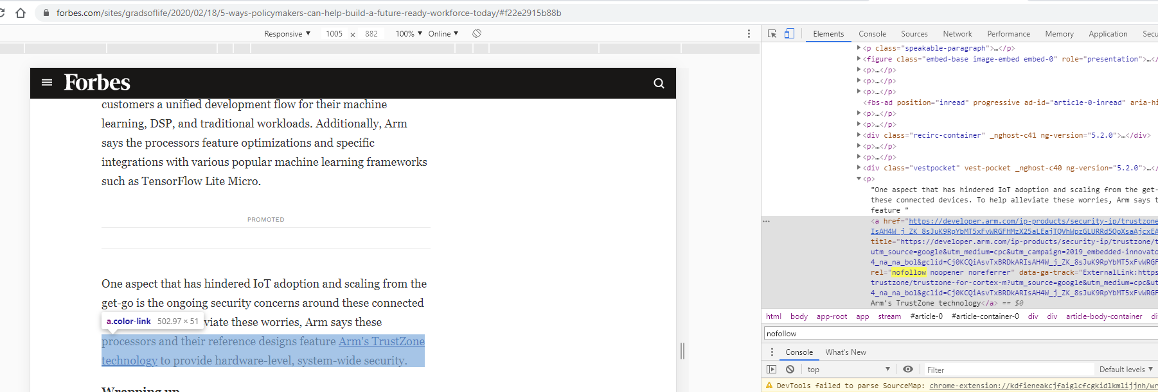
https://www.forbes.com/sites/gradsoflife/2020/02/18/5-ways-policymakers-can-help-build-a-future-ready-workforce-today/#f22e2915b88b

Slide 28
Mobile Friendly Websites
A significant number of searches performed each day are through mobile devices.
A mobile friendly web site vs. Android, iPhone or Windows Mobile app

Slide 29
Content is still king
Content is still king and a web site with good, original, quality content can do better in the long run (with or without SEO).
Google’s official view about content length is very clear: Short content can be useful and rank well.

Slide 30
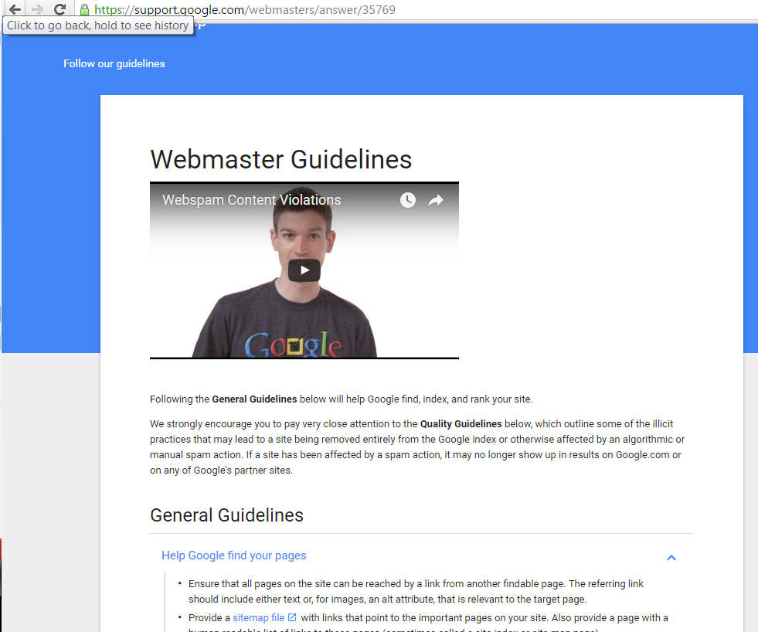
Webmaster guidelines from Google
https://support.google.com/webmasters/answer/35769

Slide 31
Read
https://www.reliablesoft.net/seo-tips-for-beginners-15-ways-to-google-boost-your-web-site/
for more SEO optimization methods

Slide 32
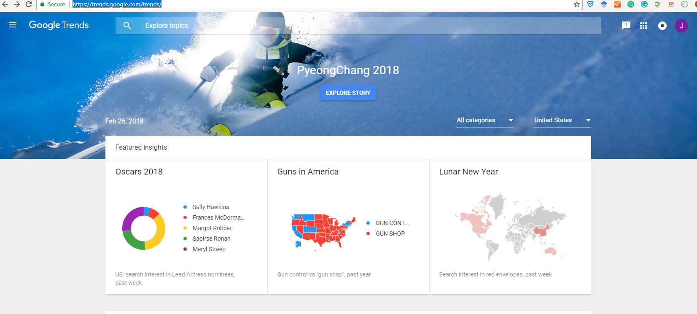
SEO tools
https://blog.bufferapp.com/free-seo-tools

Slide 33
SEO Tools
Google Analytics
PageSpeed Tool
Google Trend
Google Keyword Planner
https://developers.google.com/speed/pagespeed/insights/
https://www.lunametrics.com/blog/2018/01/25/2018-favorite-free-seo-tools/

Slide 34

https://www.rankwatch.com/tools/web-analyzer.html/

Slide 35
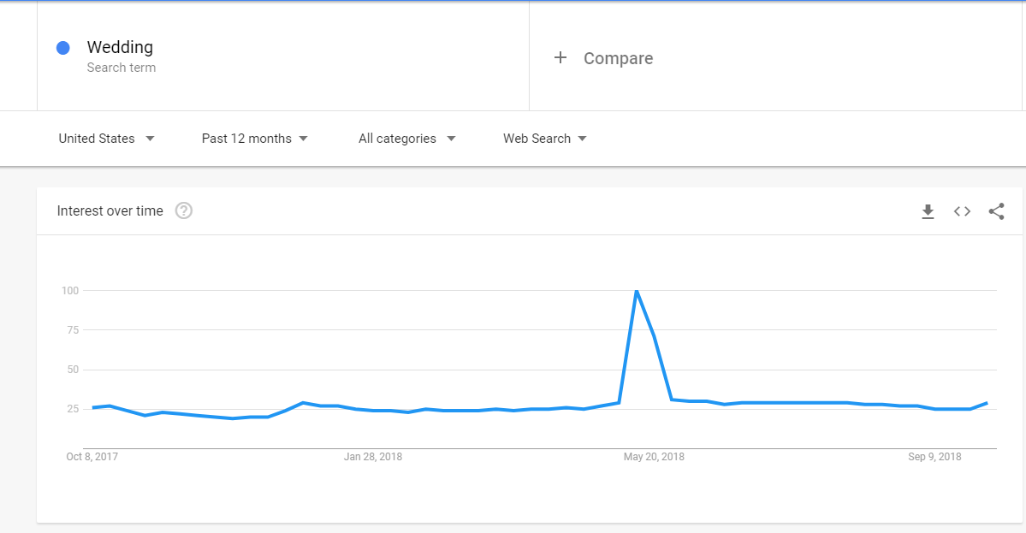
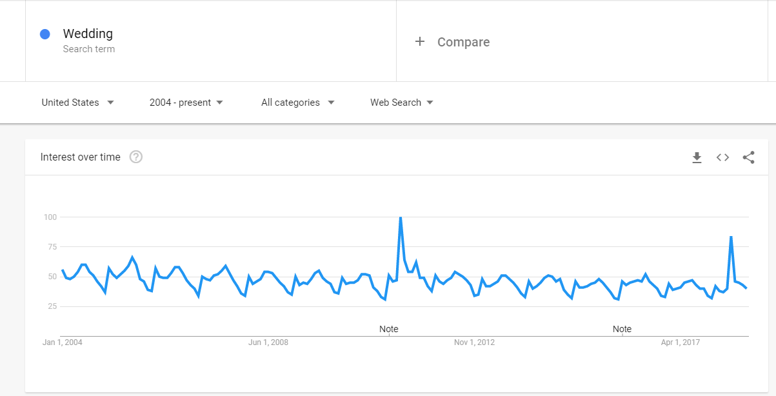
Timing
https://www.searchenginejournal.com/google-trends-seo/226809/

Slide 36
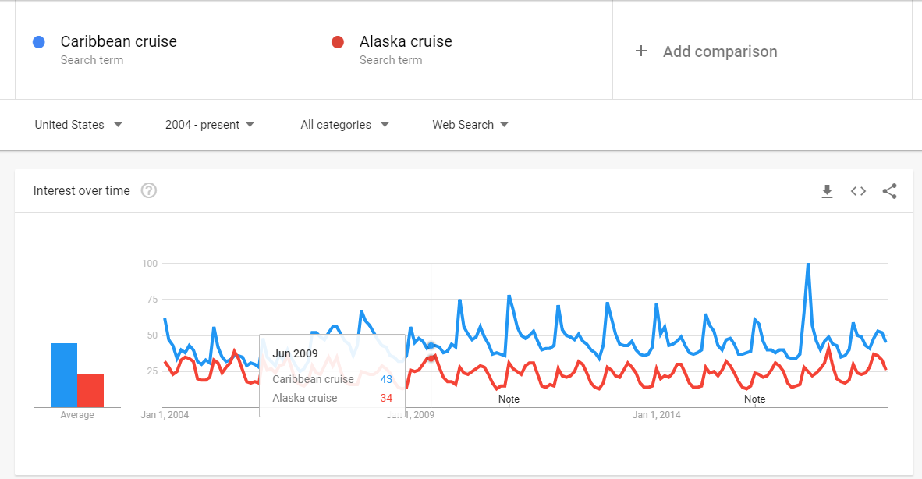

Slide 37
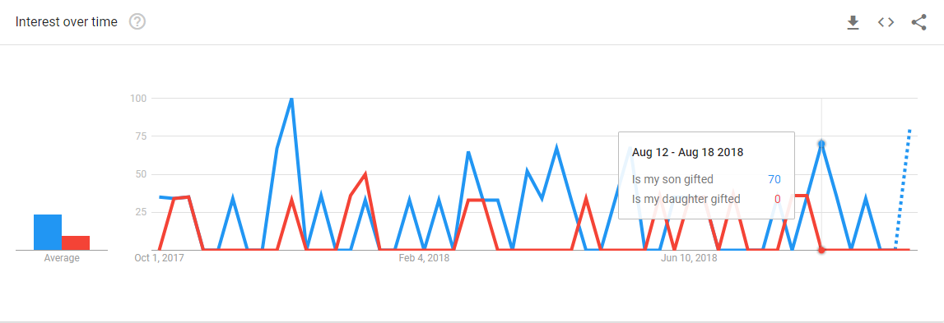

Slide 38
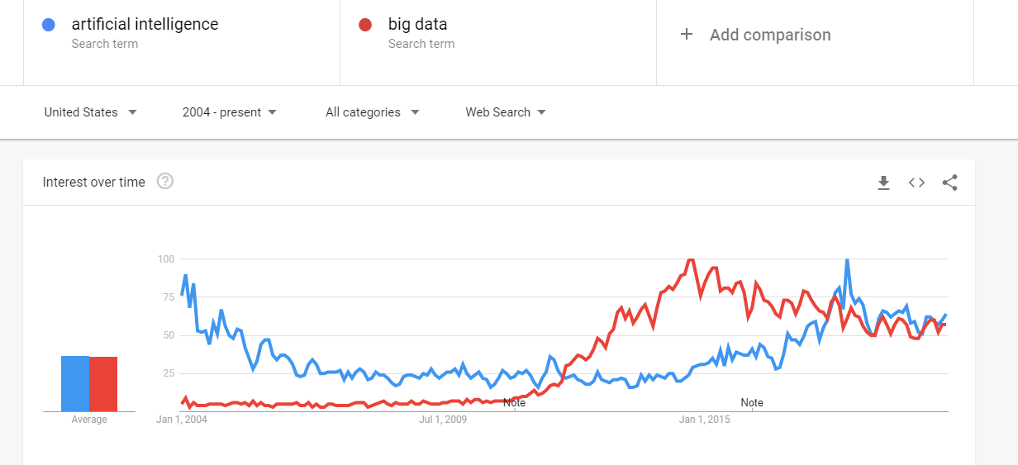

Slide 39
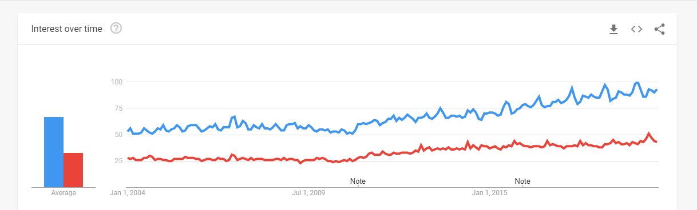

Slide 40
Reminders
Exam 1 on 10/19. The review is in the week 6 folder
Prepare for the heuristic evaluation presentation on 10/5
Individual assignment 5-SEO 10/12

